Slide 1
Medicare Health Insurance
What You Need to Know to Avoid Costly Mistakes Webinar
2022 Plan Year | January 1 – December 31 | All Changes Effective January 1, 2022
Plans for Medicare Eligible Members
Notes:
Good morning INTRODUCE
Name, title, etc.
Thank you for joining us today to learn about how to avoid issues with your CTPF health insurance.

Slide 2
Agenda
Health Insurance Enrollment and Eligibility
Important Information to Consider
Avoid Costly Mistakes
Questions & Answers
Important to Note: We will not be answering questions about what Medicare covers or does not cover. Please reach out to Medicare for these types of answers.
Notes:
Please find our agenda here. We will cover CTPF coverage, common issues we see and how you can avoid them going forward.
We have the CTPF Health Insurance Department on this meeting who can assist with answering your questions. Please enter questions in the Q&A section, not the Chat feature please, and at the end we will have time read and respond to questions.
Important to note, we will NOT be able to answer questions about what Medicare covers and doesn’t cover – you would need to reach out to Medicare for these types of answers.

Slide 3
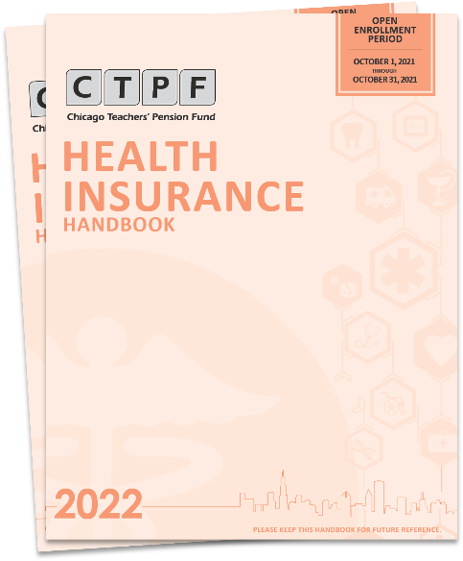
CTPF’s Medicare Health Insurance
Let’s Review CTPF’s Health Insurance:
Open Enrollment ended October 31, 2021. No enrollments accepted after that date.
CTPF offers three Medicare eligible health insurance plans with Medicare Part D prescription coverage for 2022:
UnitedHealthcare Medicare Advantage PPO,
Humana Medicare Advantage HMO, and
AARP Medicare Supplement Plan F.
Members CANNOT be enrolled in the CTPF health insurance plan AND an outside health insurance plan
Centers for Medicare and Medicaid Services (CMS) disenrolls member before we are even notified
Notes:
Let’s review the CTPF’s health insurance for members on Medicare.
First off, Open Enrollment closed on 10/31 – no enrollments are accepted after this date.
We offer 3 plans – United Healthcare Medicare Advantage PPO and Humana Medicare Advantage HMO are open to all eligible Medicare eligible retirees. If you were age 65 by January 1, 2020, you would be eligible for the AARP UnitedHealthcare Plan F too. Of course, all of our plans offer prescription coverage (also known as Medicare D)
If you are looking for a dental plan, RTAC does offer coverage to buy – see page 42 of the 2022 handbook.
Often we hear that members are confused about vision and hearing, if you review pages 36 and 37 of the 2022 handbook, our plans do offer some options for vision services and hearing.
Important note that you’ll notice in the 3rd main bullet is that you cannot be enrolled in two plans. CMS will disenroll you from the CTPF plan– most of the time before we are even aware.

Slide 4
Don’t Make Costly Mistakes
There are two common mistakes members make which may result in a loss of your current CTPF health insurance coverage:
Please take whatever steps necessary to avoid making any of these mistakes
Enrolling in an additional outside health insurance plan
OR
Failing to make timely Medicare Part B (or IRMAA B or IRMAA D) payments.
Notes:
There are two frequent mistakes members make which can result in a loss in coverage:
failing to make timely Part B payments and
enrolling in an additional outside plan.
We will discuss what these two mistakes mean.

Slide 5
Have you heard this before?
No
Teledoctors!
Copays!
Vision!
Hearing!
DON’T DELAY –
GET WHAT YOU DESERVE
Free Rides
To the Doctor!
Dental!
Notes:
How many times have you heard “Don’t delay! Hurry - Get what you deserve!”?
Some of us consider calling, given their urgency, to see if we can save money….some of us call to see if we can get dental or vision or hearing…or you see the commercials….

Slide 6
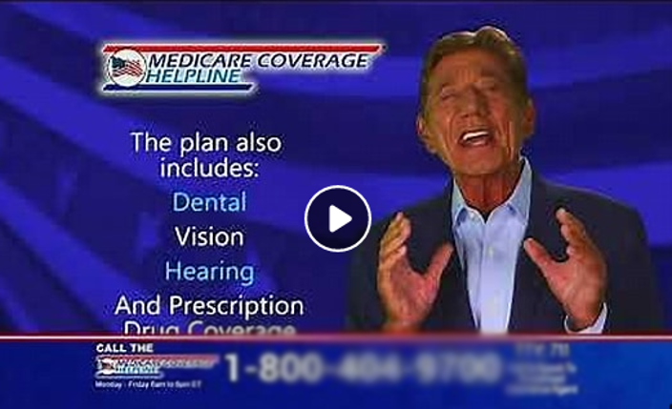
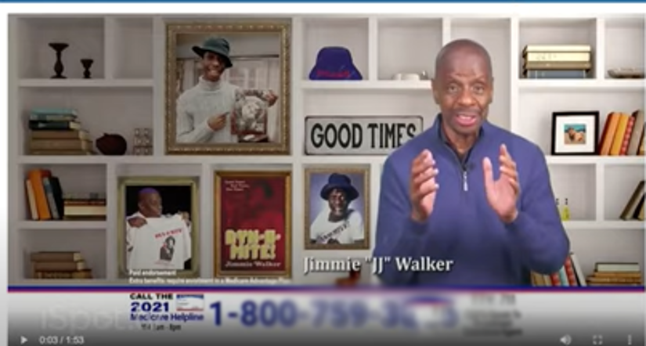
Have You Ever Seen These Commercials Urging You to Call Now?
Medicare Open Enrollment: October 15 – December 7, 2021
Notes:
I watch the Hallmark Channel a lot. Sometimes at one commercial break, I can see one, two or three commercials urging me to call now! They use actors from our past that make us think, hmm maybe I should call to see if it will be better…my best advice, don’t call unless you are seriously considering changing plans….

Slide 7
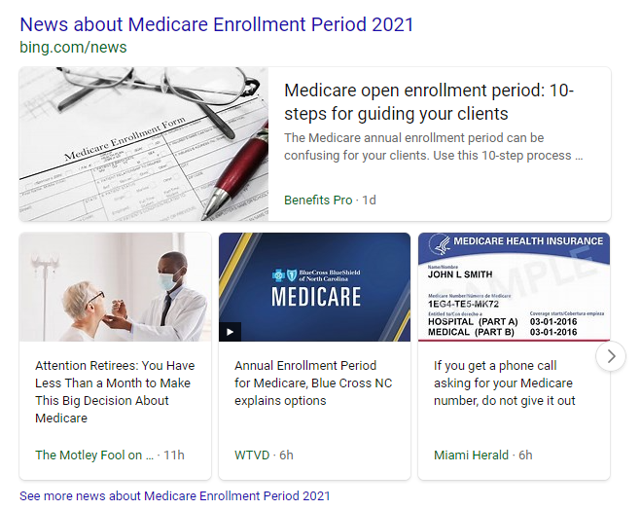
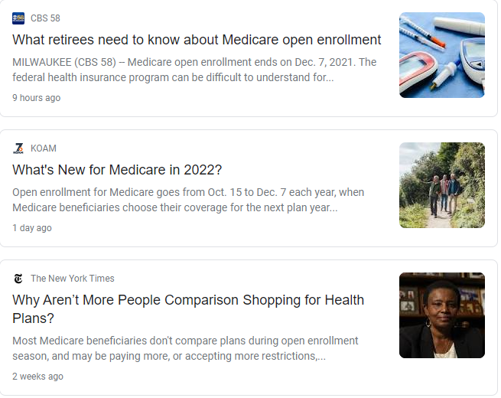
What You Need To Know
Advertisements Everywhere!
Mail, Search Engine Ads
Notes:
In addition to commercials, advertisements are everywhere! I open my Google feed and have articles and advertisements staring right back at me. I open my Yahoo account and the ads are about Medicare plans urging me to enroll by the deadline.
Sometimes you walk into the pharmacy or a hospital, you see a representative from one of the carriers and they engage you in a conversation. Before you know it, you’re telling them information and they are enrolling you in an outside plan and you don’t even know it happened.
It feels like too much and all of this really hurts our members. My best advice is ignore any and all non-CTPF communications unless you plan to change your health insurance.

Slide 8
Don’t Make Costly Mistakes
What is the difference between CTPF’s Open Enrollment and Medicare Open Enrollment?
CTPF’s Open Enrollment was October 1 through
October 31, 2021
Medicare’s Open Enrollment started October 15 through December 7, 2021
CTPF members currently enrolled in a CTPF’s health insurance plan should NOT take part in Medicare’s Open Enrollment
Notes:
So let’s discuss the differences…
CTPF’s open enrollment is closed…it was October 1st through the 31st. However Medicare’s open enrollment goes from October 15th through December 7th.
But as CTPF members enrolled in our health insurance, we do NOT need to do anything for Medicare’s open enrollment

Slide 9
Don’t Make Costly Mistakes CONTINUED
What should you do during Medicare’s Open Enrollment? Nothing
Ignore the propaganda
Contact CTPF if any outreaches occur
Questions or in doubt? Call CTPF’s Member Services at 312.641.4464 between 8 am and 5 pm CT, Monday through Friday.
Notes:
Again I reiterate…please do nothing for Medicare’s open enrollment…
As hard as it can be, I ask you to ignore the propaganda, advertisements, calls to your home, commercials, walk ups….if in doubt, please call CTPF’s Member Services.
Yesterday, CTPF Communications sent out an E-News that highly recommends adding CTPF’s numbers to your saved contacts so that you know it’s us if you receive a call.

Slide 10
Don’t Make Costly Mistakes CONTINUED
Enrolling in an Outside Plan or an Additional Plan:
If you have CTPF’s Health Insurance Plan and enroll in an additional outside plan, you will be disenrolled by Medicare and you will lose your CTPF Health Insurance plan coverage. Reinstatement is difficult and may result in additional penalties.
Recommendation: Be very cautious when speaking to a broker or infomercial advisor regarding your insurance plan and the impact on your CTPF coverage.
Notes:
Before you pick up the phone, we HIGHLY recommend that you stop. Once you call or accept that call, they often enroll you without you realizing it.
If you enroll in an additional plan, medical or prescription, you are disqualified from CTPF’s medical and prescription plans. You will be disenrolled by Medicare and you will lose all health insurance coverage and the subsidies that go with it.
See page 31 for additional information and contact Members Services at 312.641.4464 or email memberservices@ctpf.org for additional help.
Reinstatement is difficult and may result in additional penalties.

Slide 11
Don’t Make Costly Mistakes CONTINUED
Enrolling in an Outside Plan or an Additional Plan:
During this Medicare’s Open Enrollment window, Medicare eligible participants can enroll in coverage. However, if you participate in a CTPF Medicare health insurance plan, it’s important to understand the facts:
If you enroll through one of the many health insurance plans heavily advertised on television, radio, social media or multiple solicitations, you will be disenrolled from your CTPF health insurance plan.
If you later decide that you are unhappy with a non-CTPF plan and want to rejoin a CTPF plan, you must wait until the next Open Enrollment period (October 2022), unless you have a qualifying event.
Notes:
If you enroll in an additional plan, medical or prescription, you are disqualified from CTPF’s medical and prescription plans. You will be disenrolled by Medicare and you will lose all health insurance coverage and the subsidies that go with it.
Unfortunately if you stay in the plan and later realize it’s not what you expected, you will have to wait till next year’s CTPF’s Open Enrollment in October of 2022.

Slide 12
Don’t Make Costly Mistakes CONTINUED
You can only rejoin a CTPF health insurance plan once in your lifetime, unless you have a qualifying event.
The decision to change plans should be carefully evaluated based on individual needs. Members who choose to enroll in an additional plan through the Medicare’s Open Enrollment period will be disenrolled from all CTPF’s health insurance plans by Medicare.
Notes:
In addition, you can only enroll once in a lifetime at Open Enrollment unless you have a qualifying life event
As I have mentioned, disenrollment happens by CMS which we know is the Centers for Medicare and Medicaid Services

Slide 13
Other Medicare Part D Prescription Coverage
You will receive solicitations and mailings from health insurance companies for Medicare Part D prescription plans
DO NOT ENROLL in other prescription Medicare Part D coverage
You will be disenrolled from your CTPF’s health insurance plan (both medical and prescription drug coverage)
Notes:
This time of year, everyone approaching age 65 and over starts getting inundated with mail and solicitation from all kinds of insurance companies offering Medicare prescription drug plans and Medicare Advantage plans.
Be careful and beware – if you are enrolled in one of our plans, you already have Medicare Part D prescription coverage. DO NOT ENROLL IN ANY OTHER PRESCRIPTION DRUG COVERAGE.
If you do, CMS WILL dis-enroll you and we will also have to dis-enroll you from your CTPF-sponsored Medicare plan and you will LOSE ALL of your health insurance from the Pension Fund.
Let’s talk about how this can be a costly mistake on the next slide.

Slide 14
Don’t Make Costly Mistakes CONTINUED
Part B Payments: You pay your Medicare Part B (and IRMAA B or IRMAA D) payments directly to Medicare, and receive a monthly or quarterly bill unless you:
receive a Social Security benefit,
participate in CTPF’s MedPay program, or
sign up for Medicare's Easy Pay program.
If you fail to pay your Medicare Part B bill promptly, you will be disenrolled by Medicare and also lose your CTPF Health Insurance coverage. Reinstatement is very difficult and may result in additional penalties.
Recommendation: Setup autopay on Medicare.gov for your Part B (and IRMAA B and/or IRMAA D) payment(s) so you never have to worry again
Notes:
Another common mistake we see all year around are around Medicare Part B Payments: You are responsible for making Part B payments (and IRMAA B and/or D) directly to Medicare, and will receive a monthly or quarterly bill unless you receive a Social Security benefit, participate in CTPF’s MedPay program, or sign up for Medicare's Easy Pay program.
If you fail to pay your Medicare Part B bill promptly, you will be disenrolled by Medicare and also lose your CTPF health insurance coverage including your prescription drug coverage.
IRMAA: Income-Related Monthly Adjustment Amount (IRMAA). An additional amount that must be paid for Medicare Part B and Part D by Medicare beneficiaries who have higher incomes.
We say “SET IT AND FORGET IT” – IT’S VERY DIFFICULT TO PUT YOUR COVERAGE BACK TOGETHER if it can be done at all. It can take MONTHS to resolve. We cannot reinstate until CMS approves the reinstatement, then the medical carriers and Rx carriers need to reinstate the coverage as well.
Go to the Medicare.gov website. You will need to set up “Medicare Easy Pay”. Medicare Premium Bill (CMS-500) - The “Medicare Premium Bill” (CMS-500) is a bill for people who pay Medicare directly for their Part A premium, Part B premium, and/or Part D IRMAA (an extra amount in addition to the Medicare Part D premium).
See page 31 for additional information and contact Members Services at 1-312-641-4464 or email memberservices@ctpf.org for additional help.
Reinstatement and may result in additional penalties as well.

Slide 15
What Is CTPF Doing?
We want our members to keep their CTPF health insurance plan if they desire. Our plans offer so much at a reduced premium with a subsidy applied to offset the cost.
Unfortunately, at this time of year, we are notified of hundreds of disenrollments.
The Health Insurance Department makes every effort to contact every member who enrolled in an outside health insurance plan to confirm that it was your intention to disenroll from CTPF’s Medicare health insurance plan.
We also follow up with a letter notifying the member of their disenrollment from the CTPF health insurance plan.
Notes:
What are we doing to help our members you may ask…
We want you to keep your CTPF plan – we offer great plans that are affordable
The Health Insurance Department makes every effort to call each member to discuss it but we get hundreds at this time of the year
We also send letters to ensure members know

Slide 16
What Is CTPF Doing? CONTINUED
If you think you may have fallen victim to the propaganda, please call Member Services at 312.641.4464 to request our assistance in reviewing your account.
Often, Centers for Medicare and Medicaid Services (CMS) cancels coverage before CTPF is even notified.
If you are enrolled in CTPF’s UHC Medicare Advantage or AARP Plan F, CTPF’s Health Insurance Department is able to review your account via Express Scripts’ online access to determine if you were disenrolled from our health insurance plans.
Notes:
To help our members, if you think you may have been enrolled, please call Member Services for us to help you. If you are in the AARP Plan F or UHC Medicare Advantage plan, the HID can look in Express Scripts’ system to see what CMS has (which is updated daily).
We want you to stay in our plan and continue to receive your subsidy.

Slide 17
Important Reminders CONTINUED
Stay up-to-date on changes by having your email on file at CTPF
Contact Member Services to update your email address: email memberservices@ctpf.org or call 312.641.4464, submit documents to imaging@ctpf.org or via fax at 312.641.7185
Register for email updates at www.ctpf.org
Scroll down to bottom and enter your email address
Notes:
Best way to be informed of changes:
Register for email updates on www.ctpf.org (“register for CTPF email updates”)
You may also contact Member Services via email memberservices@ctpf.org, submit documents to imaging@ctpf.org or via fax at 312.641.7185 , or call 312.641.4464

Slide 18
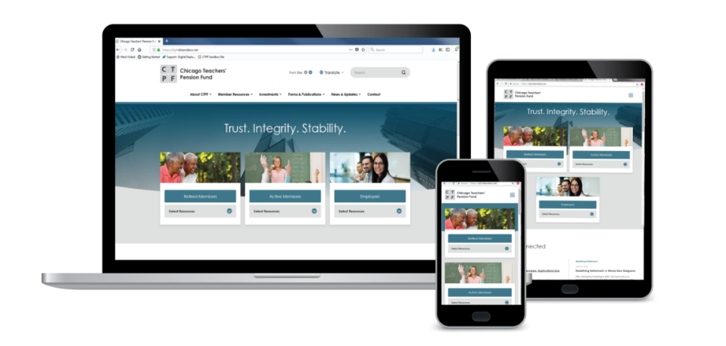
Important Reminders CONTINUED
Due to COVID-19, for the safety of our members CTPF offices are closed to visitors.
Stay up-to-date on changes online:
Visit the CTPF website at www.ctpf.org
Follow us on Facebook, Twitter, or LinkedIn
Search: Chicago Teachers Pension Fund
The best way to send documents, including Health Insurance enrollment forms or any other submissions, is by Fax to 312.641.7185 or attach to an email to imaging@ctpf.org.
Notes:
Stay up to date – Twitter OR Facebook
If you are submitting your retirement application, change of address, direct deposit, health insurance enrollment forms or any other submissions, the best way to send documents is by Fax to 312.641.7185 or attach to an email and send to imaging@ctpf.org.
Due to the Covid-19 Pandemic, for the safety of our members we are not accepting visitors at CTPF.
To expedite submission of documents, including your enrollment forms, is to
Call Member Services with questions at 312-641-4464. Phone and video counseling are available.
You may also mail documents. If you mail your documents, please allow for any delay in USPS delivery.

Slide 19
Office/Mailing Information: Chicago Teachers' Pension Fund
ATTN: Health Benefits Dept. 425 S. Financial Place| Suite 1400 Chicago, Illinois 60605-1000 312.641.4464 main 312.641.7185 fax
CTPF Medicare Health Insurance
Notes:
Thank you for your time during the presentation. We hope that this session was helpful.
We will now spend some time addressing your questions in the Q&A session.

